Slide 1














Slide 2

Thank you to our APP Sponsor
Please go to store on IOS or Android to download. Login with email used to register
Type Code #SPSOslo19

Slide 3



Thank you to Sennheiser for raffle gifts

Slide 4
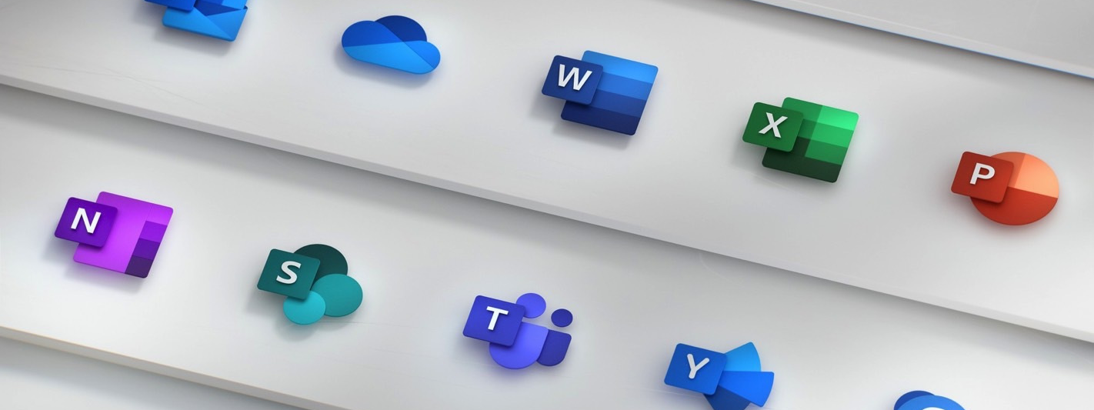
How to optimize Your files in SharePoint and Teams
Jimmy Hang | rewired

Slide 5
Jimmy Hang
Technical Architect Microsoft Certified Trainer Microsoft Certified Solutions Expert: Productivity
rewired | Crayon Group
Jimmy.Hang@rewired.no
@Hang_Jimmy
https://hangconsult.com

Slide 6
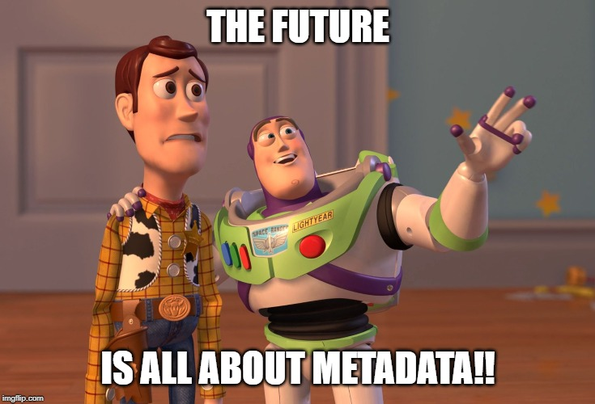
Agenda
Where are we?
Migration options
File Metadata
What is Document Set?
Presentation using Modern Search Webpart

Slide 7
Where are we?
Planning migration?
Completed migration?
Using metadata?
Know what Document Set is?
Try out Modern Search yet?
Can’t find anything in SharePoint

Slide 8
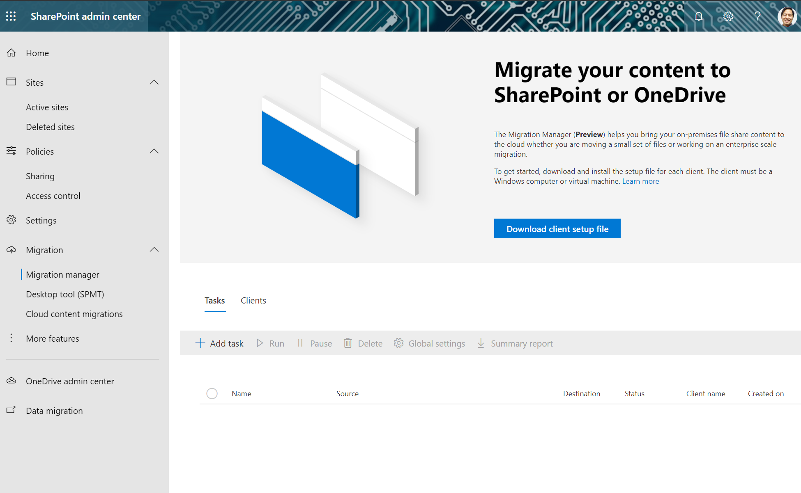
Migration Options
SharePoint Migration Tool, Microsoft Migration Manager
Its a free service
Cloud migrations (only NA)

Slide 9




Migrations Options - $$
ShareGate
AvePoint
Quest

Slide 10
Migration tips
Run with multiple service accounts to avoid throthling
Run after business hours to avoid throthling
Think about how the documents will live in Teams
Dont leave the users to do it all by themselves

Slide 11
Metadata
Wikipedia
“Metadata is "data that provides information about other data".^{[1]} In short, it's data about data. Many distinct types of metadata exist, including descriptive metadata, structural metadata, administrative metadata,^{[2]} reference metadata and statistical metadata.^{[3]}”

Slide 12
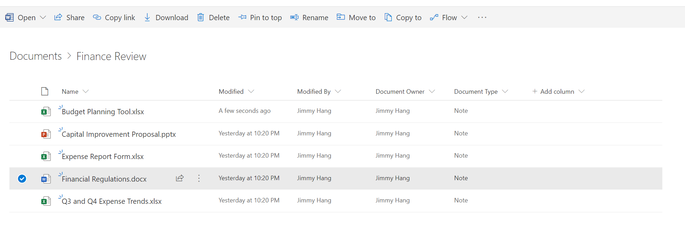
Metadata in SharePoint
Search
Business workflows

Slide 13
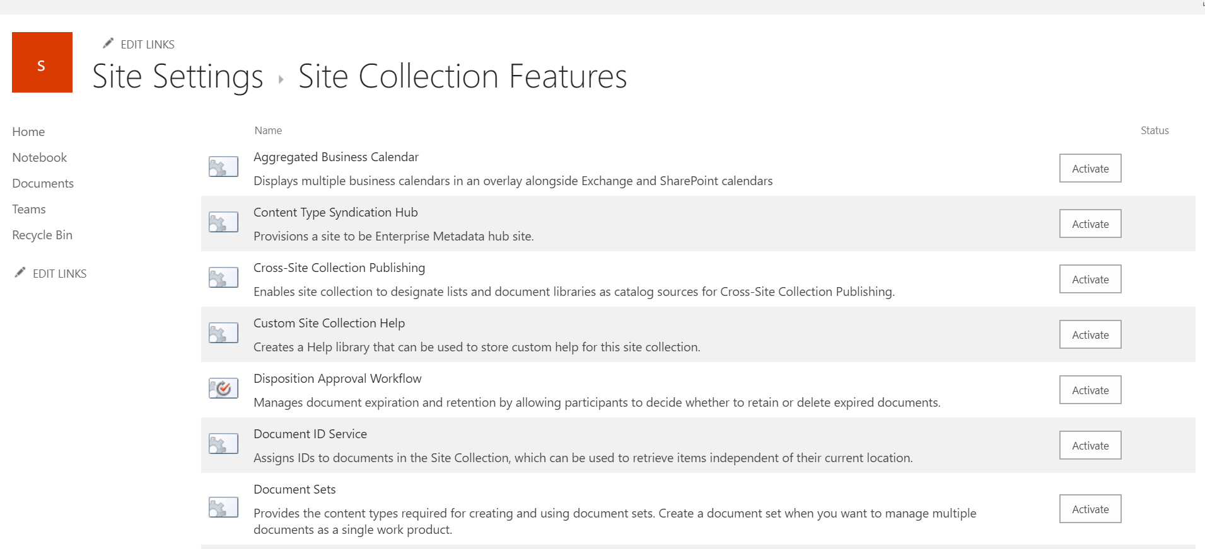
Document Set
Grouping of Content
Metadata inheritance -> auto tagging
Business workflow
Now support #spmodern
Works great with OneDrive sync

Slide 14
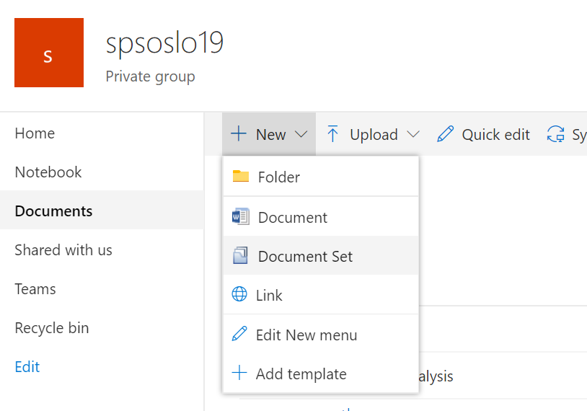
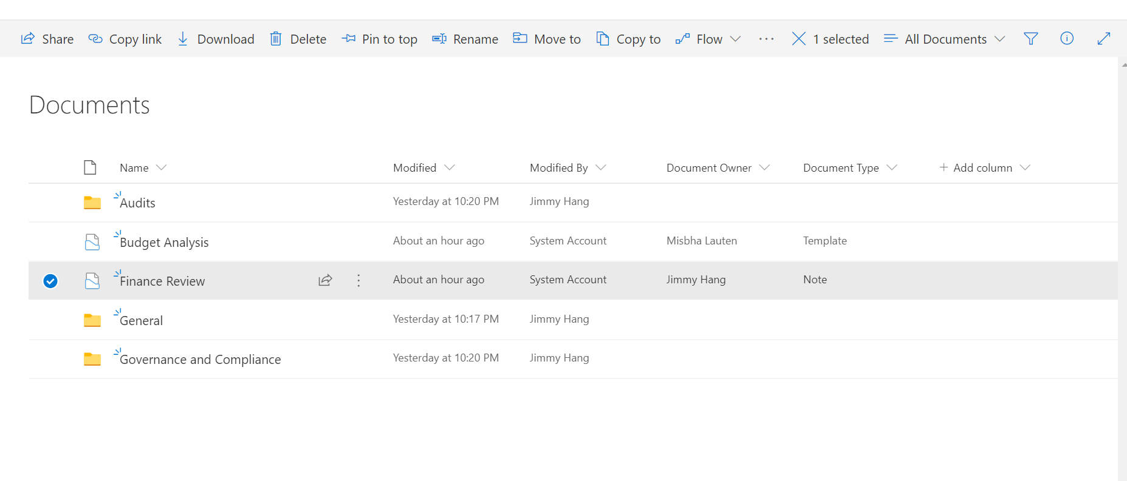

Slide 15
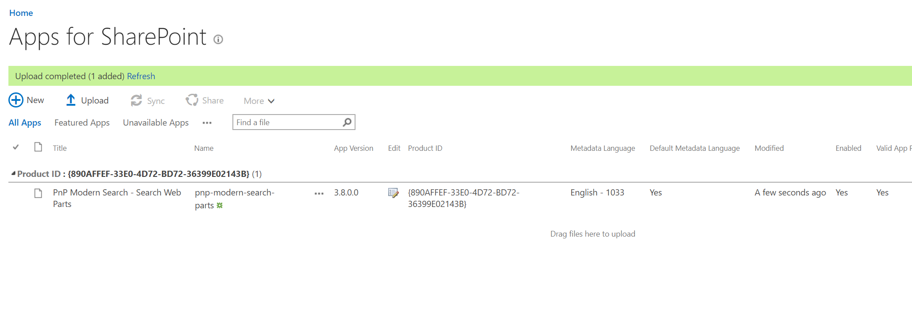
PnP Modern Search
https://github.com/microsoft-search/pnp-modern-search

Slide 16
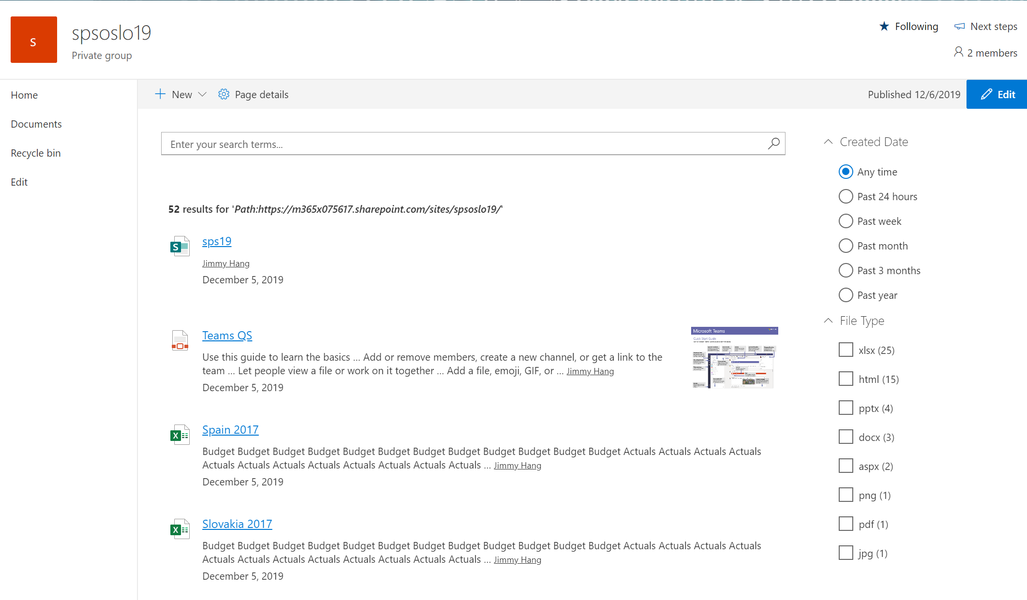

Slide 17

Demo

Slide 18
Key takeaways
Always plan your metadata
Use «Document Set» to achieve auto tagging whenever you can
Use Modern search webparts to present metadata benefits

Slide 19
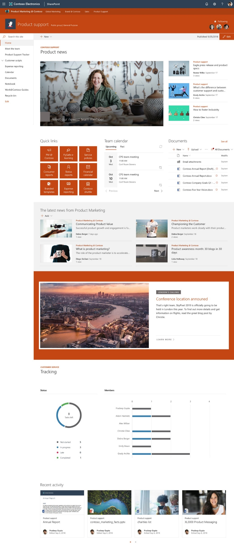
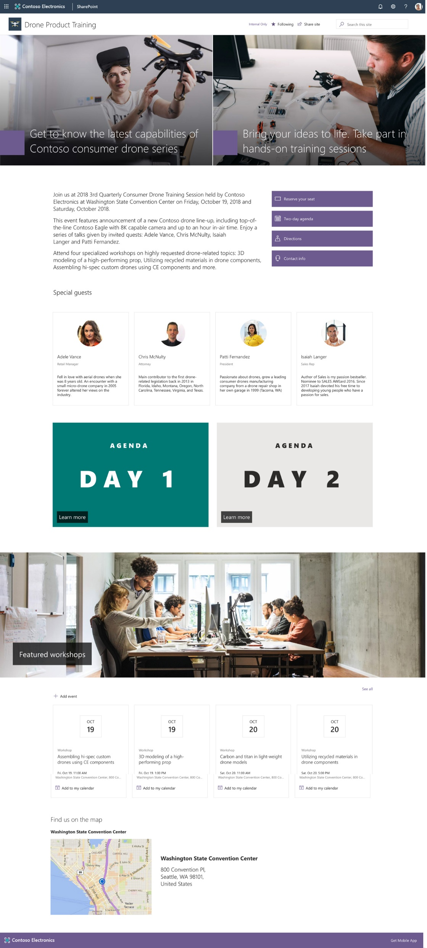
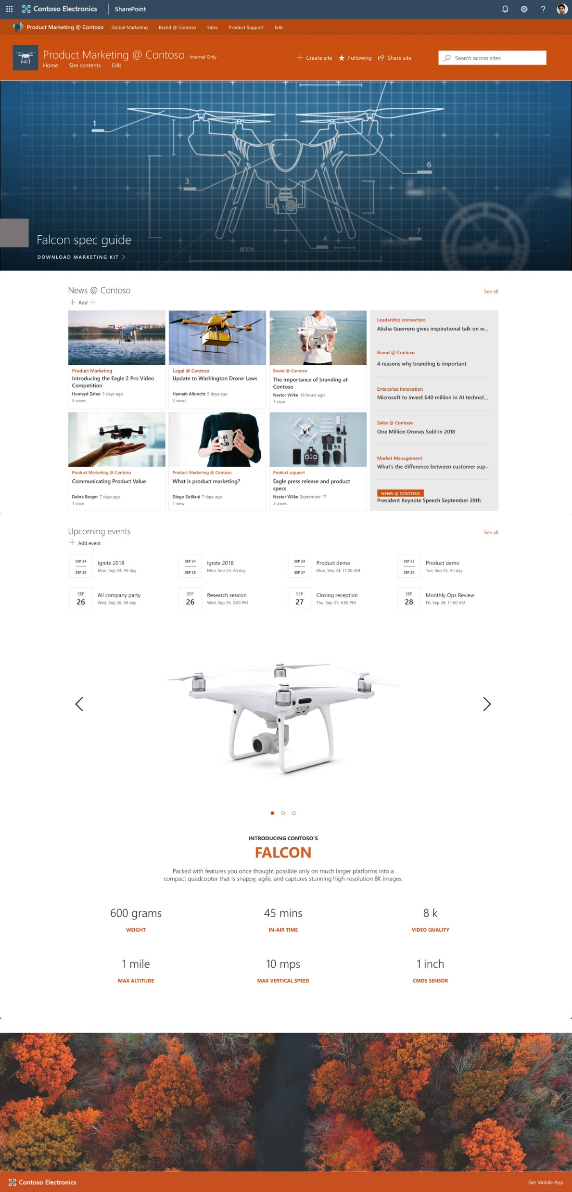

Slide 20
Q & A

